Slide 1
Predicting ECG Diagnosis using Machine Learning and Deep Learning
Course: Introduction to Artificial Intelligence (Summer 2026)
Authors: Jan Czerwienko, Aleksander Mogiła
Abstract: Multi-class classification of 12-lead ECG signals using the CPSC-2018 dataset

Slide 2
Dataset Architecture
Binary Data (.mat): Stores the raw electrical activity of the heart across all 12 spatial leads as a high-dimensional matrix. It cannot be read as plain text and requires the wfdb library.
Technical Headers (.hea): Text metadata containing recording parameters (duration, number of leads, sampling frequency) and hardware-to-voltage scaling calibrations (Scale, Baseline, Checksum).
Clinical Metadata: Embedded at the bottom of the header file, tracking medical demographics (Age, Sex) and clinical classification codes (Diagnosis, Medications, History).

Slide 3
Diagnosis Distribution & Class Imbalance
Dataset Scale: 6,877 unique patient records spanning 9 distinct diagnostic categories.
Severe Class Imbalance: The most frequent class (59118001) has 1,857 samples, while the rarest (164931005) has only 220 samples—a ratio exceeding 8.4x.
Clinical Significance of Codes:
426783006: Normal Sinus Rhythm (NSR) — the only healthy control class in the dataset.
All other 8 codes represent critical cardiac conditions (e.g., Atrial Fibrillation, Bundle Branch Blocks, ST Changes).
Algorithmic Challenge: Standard training without intervention would bias the model toward dominant classes, ignoring rare but life-threatening pathologies.

Slide 4
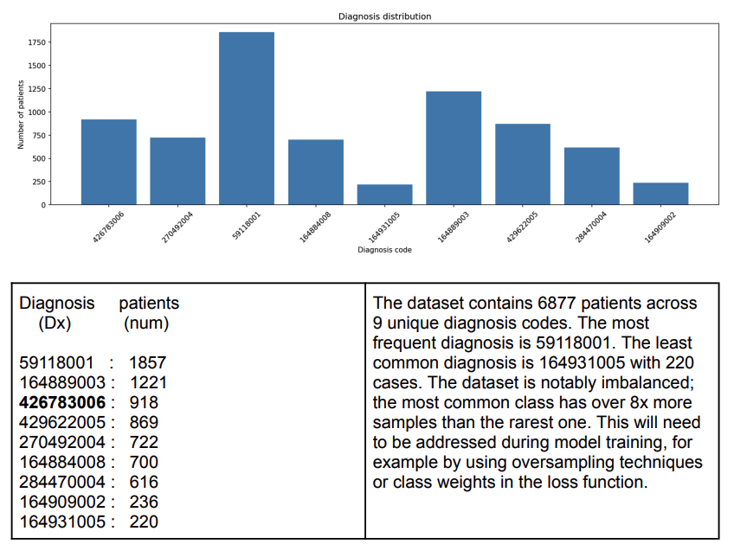

Slide 5
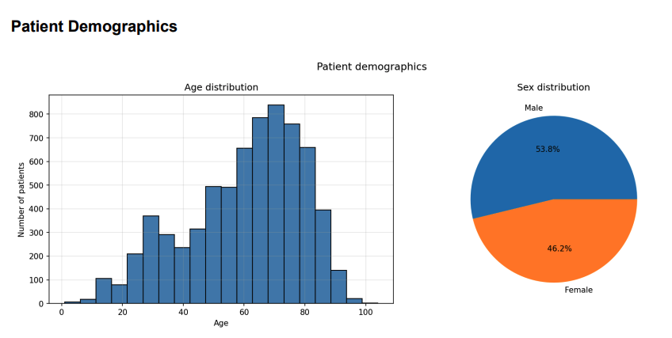
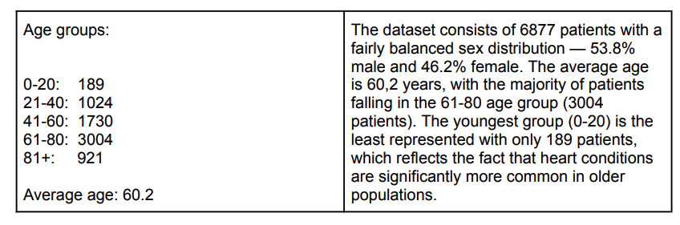

Slide 6
1D ECG to 2D Spectrogram Transformation
Methodology: Converts 1D raw voltage time-series data into a 2D time-frequency representation using Short-Time Fourier Transform (STFT).
Feature Extraction: While 1D signals only show voltage over time, a 2D spectrogram simultaneously exposes temporal structures and hidden frequency patterns (e.g., rapid energy bursts of heartbeats).
Computer Vision Approach: Transforms a complex signal-processing task into an image classification problem. This allows Deep Learning models (like 2D-CNNs) to recognize distinct geometric shapes and color distributions.
Multi-Lead Integration: Each of the 12 denoised ECG leads is transformed into an individual spectrogram. These are later stacked or concatenated to preserve the multi-angle clinical view of the heart.

Slide 7
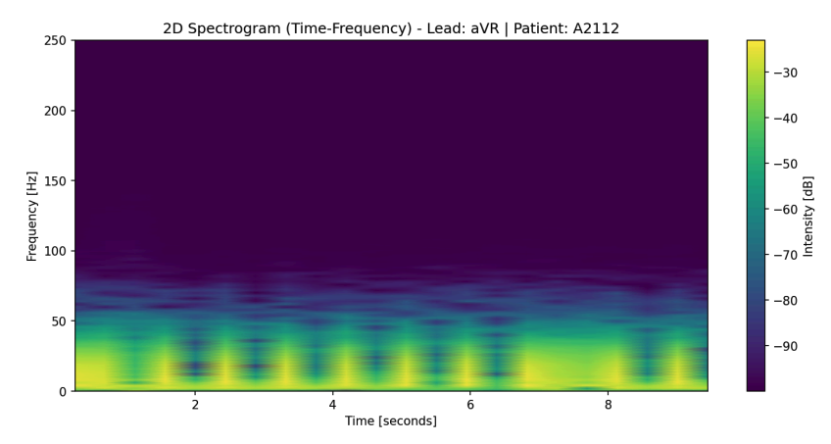

Slide 8
Preprocessing & Hyperparameter Pipeline
Multi-label Target Binarization: Converted multi-diagnosis text notes into a structured array of binary labels using scikit-learn's MultilabelBinarizer to reflect the multi-label, multi-output classification nature of the task.
Noise Suppression: Applied pre-processing filters to raw 1D signals to reduce artifacts and clinical noise before computing the time-frequency representations.
Pipeline Tuning Variables (Hyperparameters):
nperseg: Defines the segment length during Short-Time Fourier Transform generation.
length_cap: Minimum duration boundary in seconds (shorter patient samples are automatically discarded).
split_extra_samples: Segmenting longer recordings into equal blocks to artificially expand instances of rare labels.

Slide 9
Troubleshooting & The Learning Breakthrough (nperseg)
The Core Crisis: Initial 2D-CNN training iterations completely failed. The loss function stagnated, and the models returned zero predictions for uncommon cardiac categories.
The Root Cause (Temporal Blur): Default spectrogram parameters utilized a high nperseg window (128 or 256). This blurred rapid, transient events like the QRS complex (heartbeats lasting only ~80-120 ms), making patterns unreadable for CNN layers.
The Technical Solution: Drastically reduced nperseg to 64 and subsequently 32 during the STFT generation stage.
The Result: Sacrificing minor frequency granularity unlocked ultra-high temporal resolution, allowing the models to isolate distinct heartbeat morphology and successfully converge.

Slide 10
Preprocessed Datasets & Custom Oversampling
SMOTE Rejection: Initial attempts to use standard SMOTE were abandoned because it does not function well with multi-label, multi-output targets due to complex label co-occurrences.
Baseline vs. Optimized Datasets:
precomputed-256: Replicated initial flawed conditions (nperseg = 256, 6-second cap).
precomputed: Core optimized baseline dataset using nperseg = 32 and a 6-second cap.
Signal Slicing for Class Imbalance (Oversampling V1 vs. V2):
To fix poor detection rates, records longer than the cap were segmented into multiple valid chunks and added back as artificial training entries.
Oversampling V1: Targeted rare classes (164931005, 426783006, 429622005, and accidentally 270492004) which led to a performance jump.
Oversampling V2: Attempted to fix the targeted classes properly but yielded strictly worse performance; hence V1 was kept.

Slide 11
Training Pipeline & Evaluated Classifiers
Data Partitioning: The dataset was divided into a training-validation subset and a completely separate holdout test set using a multi-label stratified split to preserve identical diagnosis proportions.
1. Support Vector Machine (SVM) Baseline:
Cannot directly process 2D images; required flattening the 12 spectrograms into a single 1D vector per patient.
Suffered from optimization and convergence struggles due to the extremely high-dimensional flattened vector space.
2. Custom 2D Convolutional Neural Network (2D-CNN):
Treated the stacked multi-lead spectrograms directly as image inputs.
Configured to extract local, spatial-temporal features and patterns from the multi-channel tensor.
3. Deeper Architectures (ResNet-18 & CNN-LSTM):
Tested to evaluate whether deep residual mapping or temporal recurrence could improve performance over the simpler CNN baseline.

Slide 12
Multi-Label Evaluation Metrics
The Multi-Label Complexity: Since each patient can present multiple cardiac diagnoses simultaneously, standard accuracy is an invalid metric. Performance must be tracked across the entire label matrix.
Strict Evaluation Standards:
Subset Accuracy: The strictest metric; counts a prediction as correct only if the entire set of predicted labels perfectly matches the true label set.
Hamming Score / Loss: Measures the fraction of individual correct binary decisions across all labels.
Averaging Paradigms for Class Imbalance:
Macro F1 Score: Calculates the F1 score independently for each of the 9 classes and then averages them. Crucial because it gives equal weight to rare diagnoses.
Micro F1 Score: Computes the F1 score globally by counting total true positives, false negatives, and false positives across all categories.
Samples F1 & Jaccard Score: Evaluates overlapping precision and recall directly at the individual patient level.

Slide 13
Training and Experimentation

Slide 14
Failed Training

Slide 15
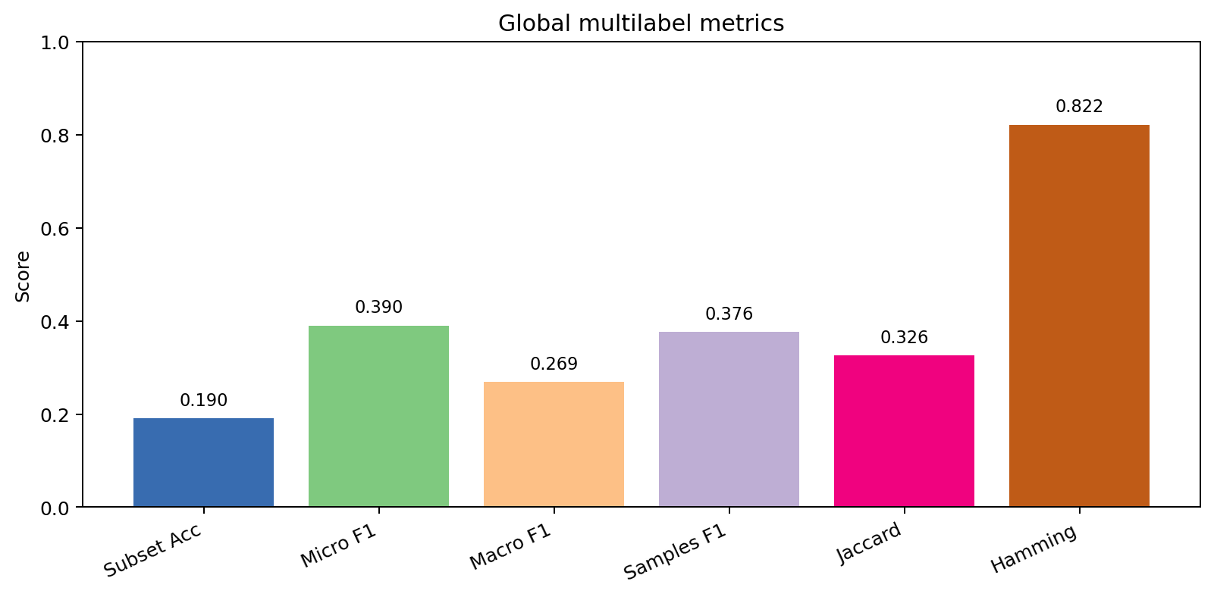
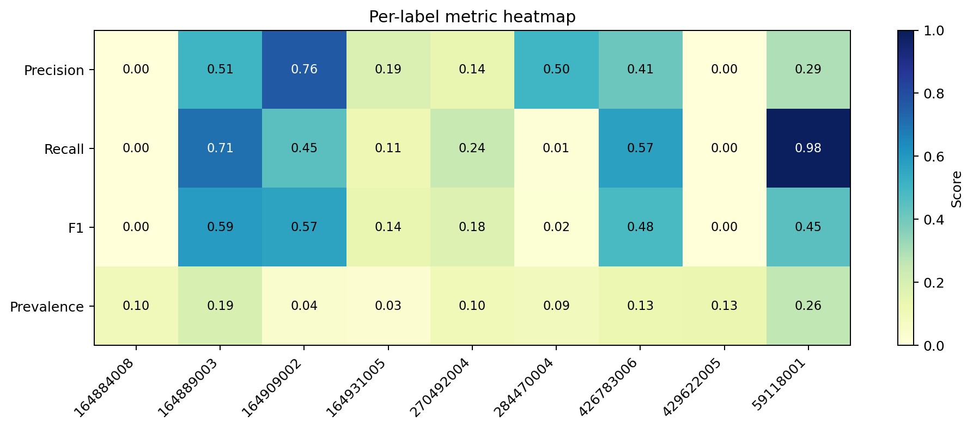
Nperseg 256 - General Performance
Experiment Name | cnn_nperseg256
dataset | precomputed-256
Model | 2d-CNN
Variant | default
iterations | 10

Slide 16
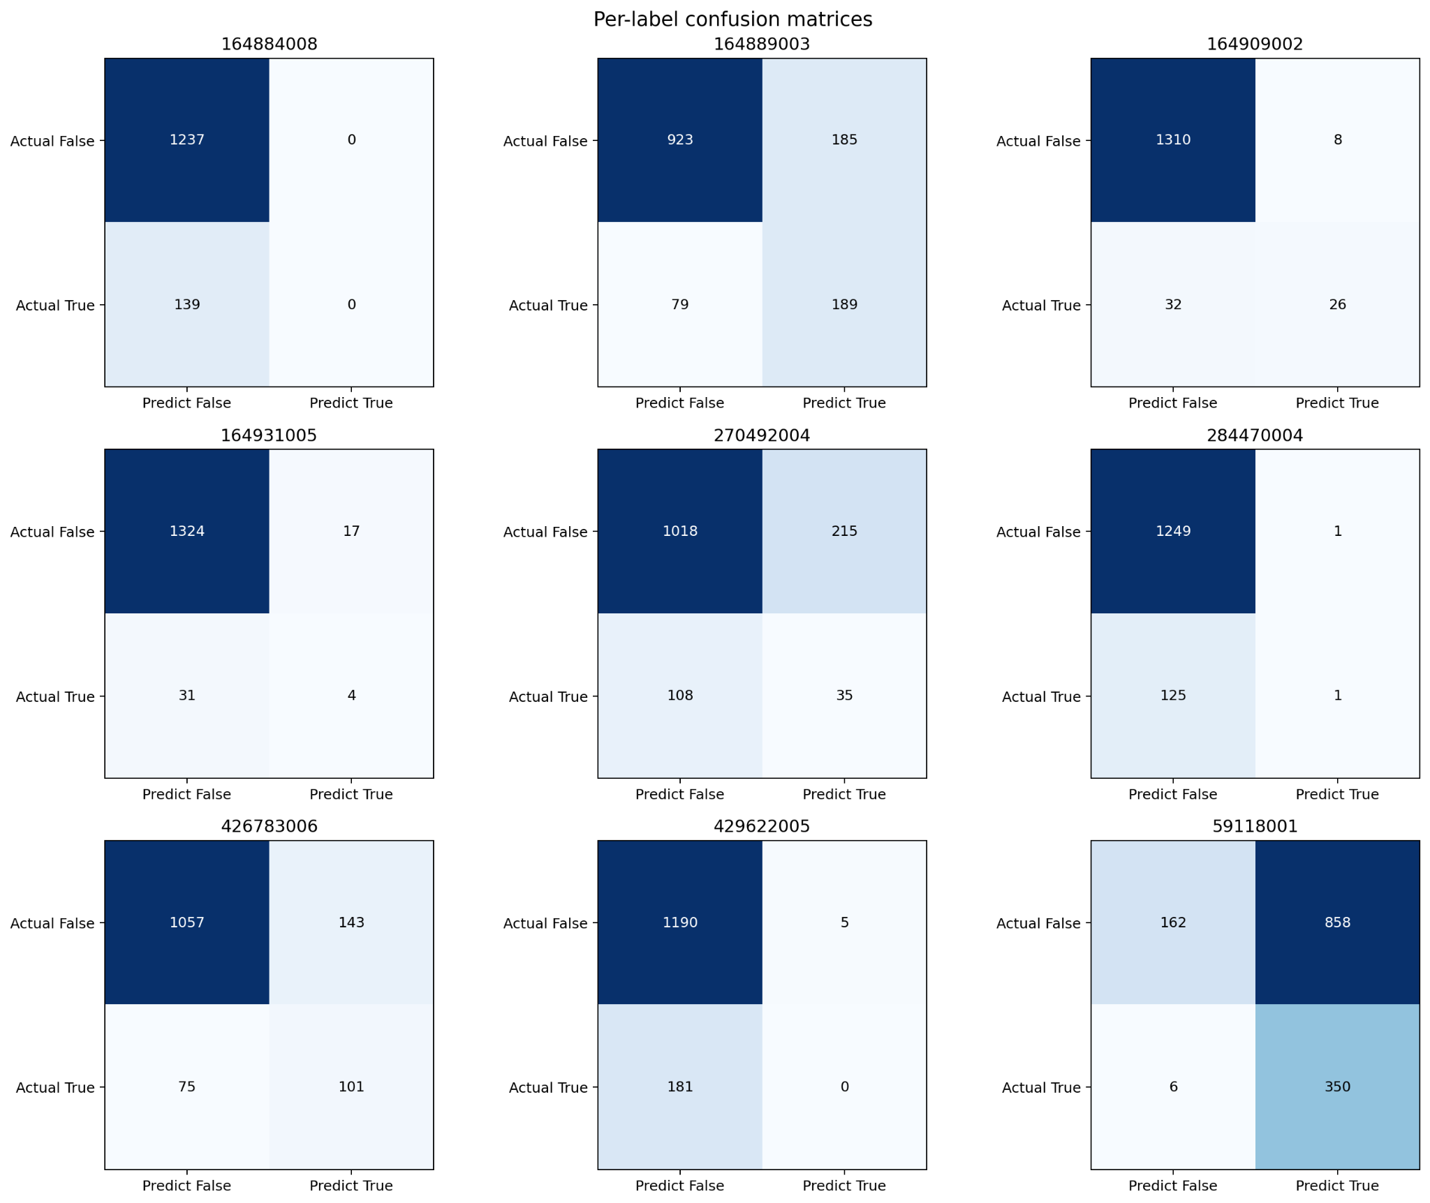
Nperseg 256 - Confusion Matrix

Slide 17
Multioutput Classifier - SVM Kernel

Slide 18
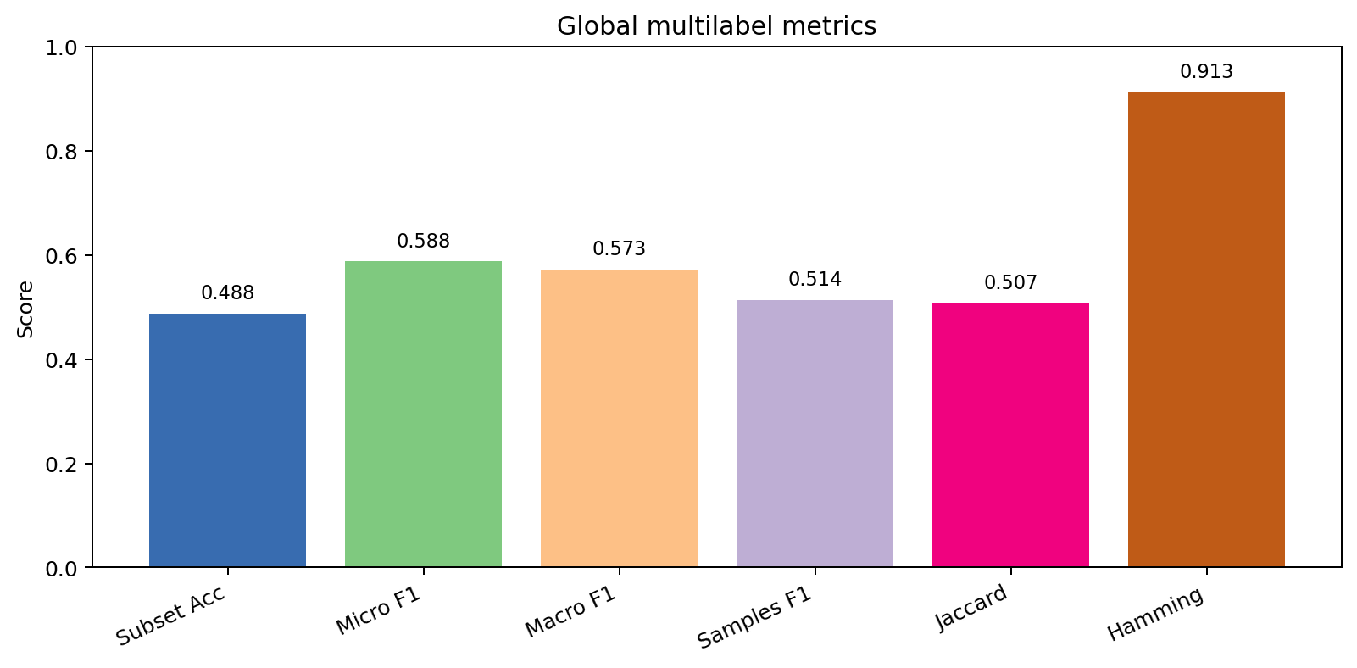
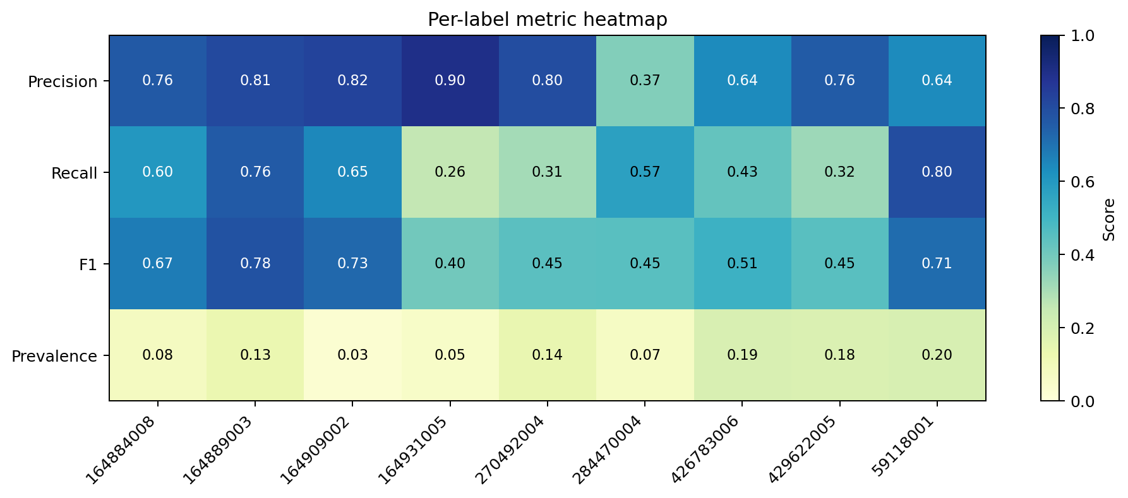
SVM - General Results
Experiment Name | svm-default-l6-oversample
dataset | precomputed-split-gen-length-6-old
Model | SVM
Variant | default
iterations | auto - controlled by scikit

Slide 19
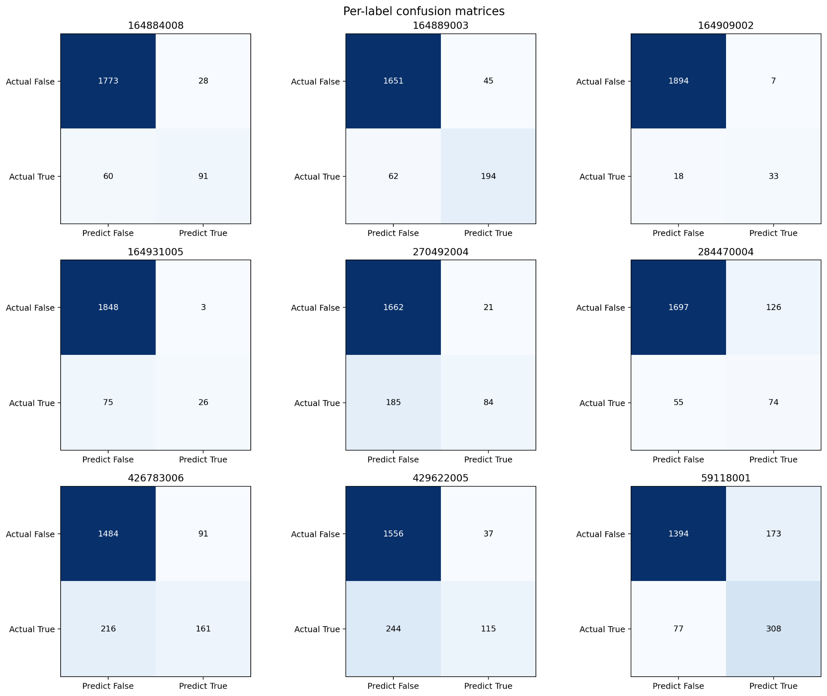
SVM - Confusion Matrix

Slide 20
SVM - Summary
Scikit-learn implementation
Slow training speed - CPU Only
CPU training slower than keras
Convergence issues
Longer datasets - exponential training time, worse performance
Poor overall performance

Slide 21
2D - Convolutional Neural Network
ResNet18

Slide 22
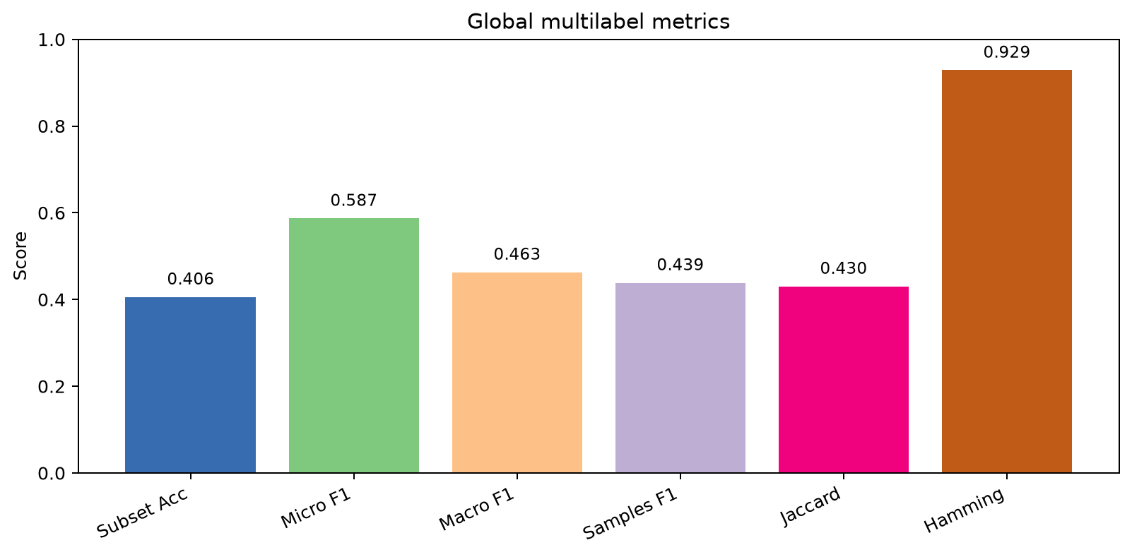
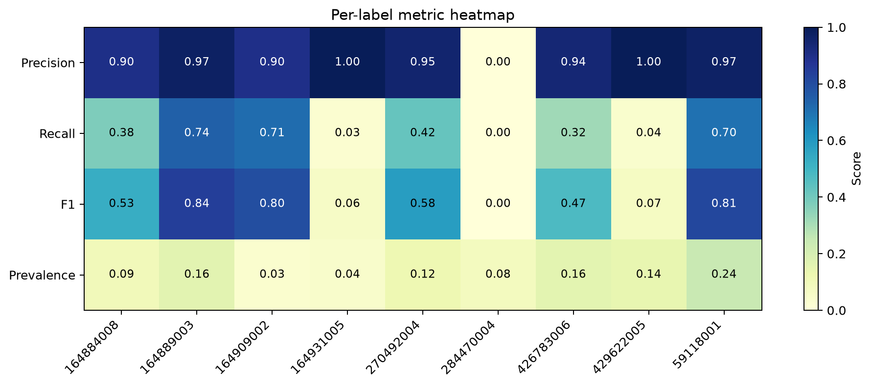
2D - CNN (ResNet18) - General Results
Experiment Name | resnet18-l10-oversample
dataset | precomputedsplit-genlength-10
Model | 2d-CNN
Variant | resnet18
iterations | 20

Slide 23
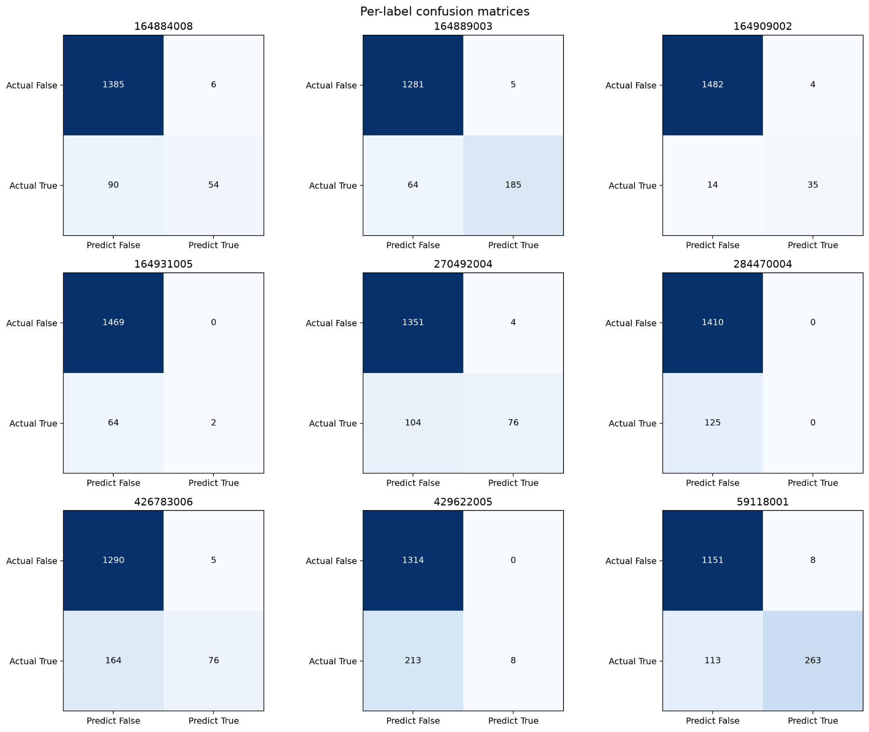
2D - CNN (ResNet18) - Confusion Matrix

Slide 24
2D - CNN (ResNet18) - Summary
Low count of matches
High precision for true positives, low false positives
Minimized loss function effectively
Very poor full-match subset accuracy with default threshold
Very slow training
Tuning binary match thresholds might improve performance

Slide 25
2D - Convolutional Neural Network
Custom Design

Slide 26
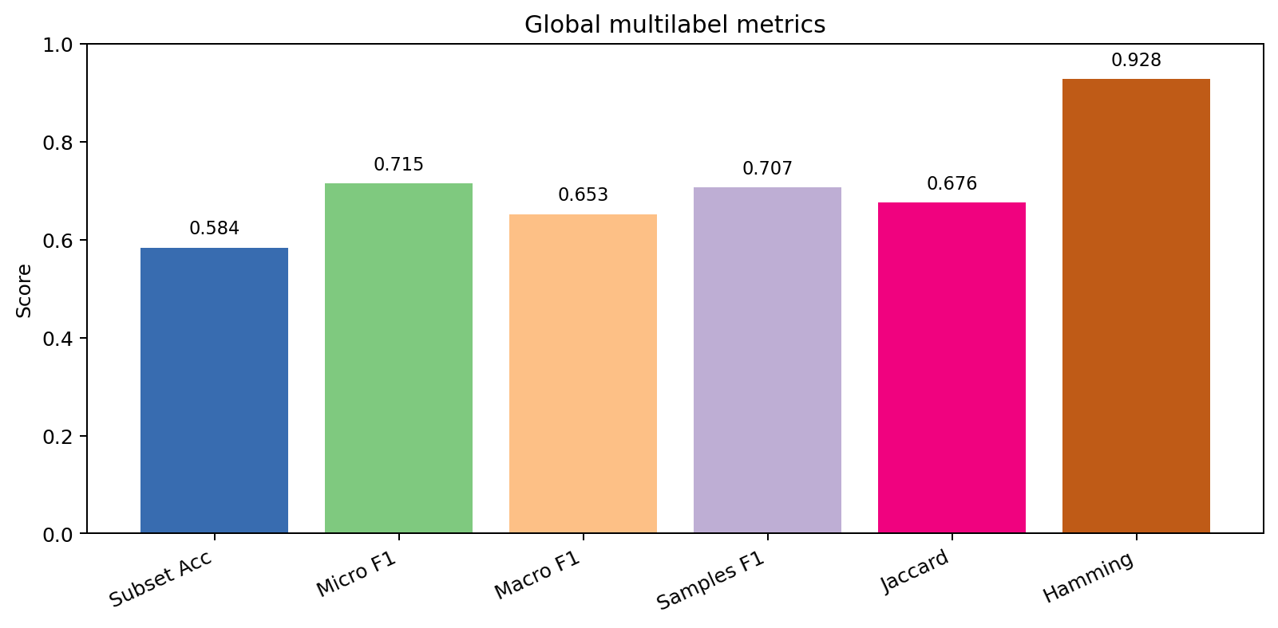
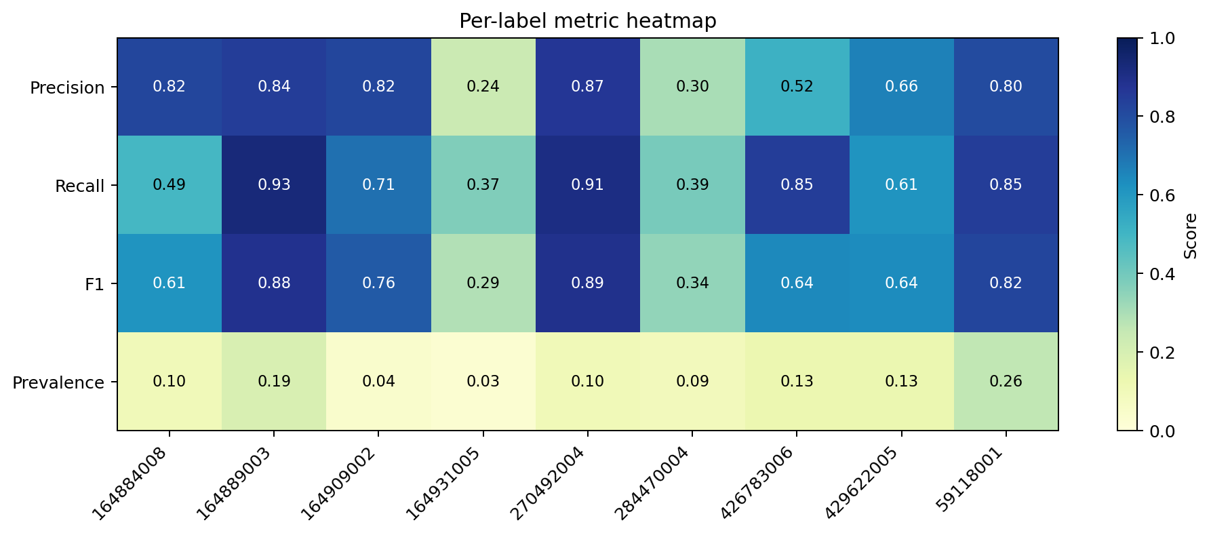
2D - CNN (Custom) - General Results
Experiment Name | cnn_nperseg_32
dataset | precomputed
Model | 2d-CNN
Variant | default
iterations | 20

Slide 27
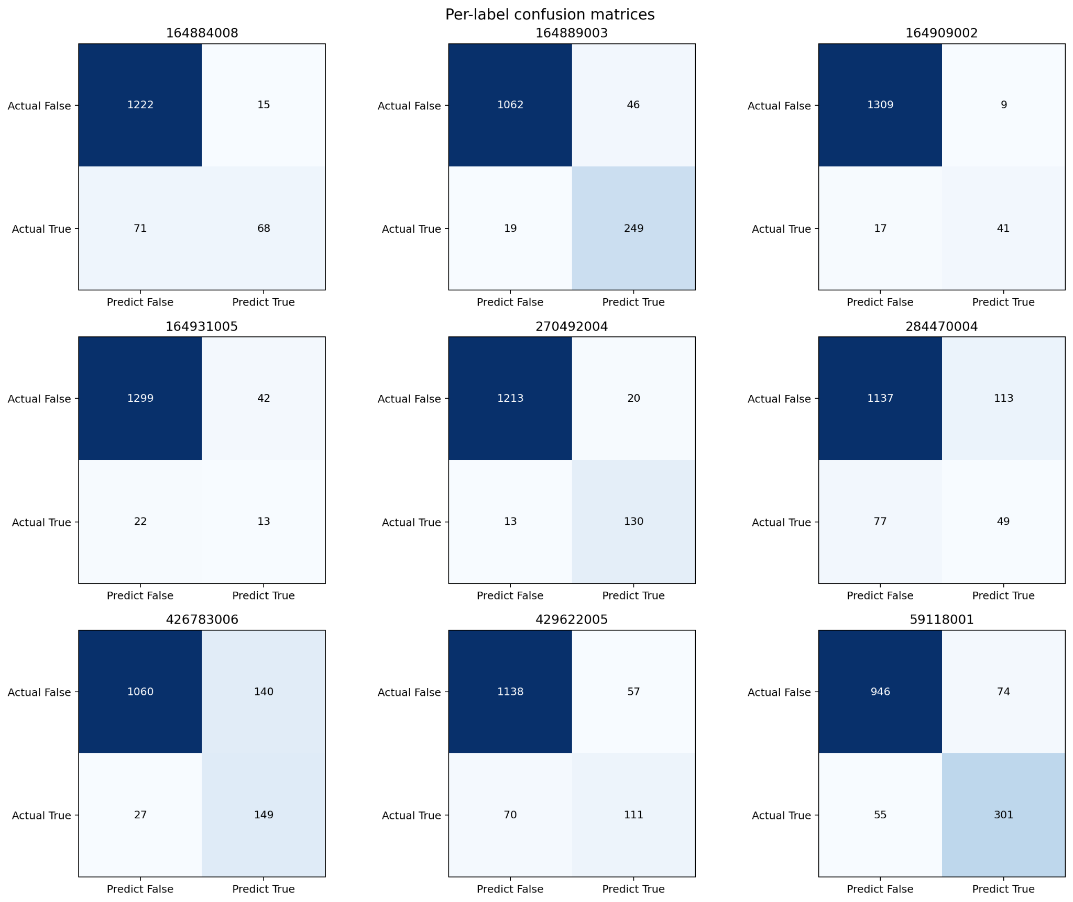
2D - CNN (Custom) - Confusion Matrix

Slide 28
2D - CNN (Custom) - Summary
Promising initial results
Fast training, with full GPU acceleration
Overfitting present
Poor precision for uncommon cases
Mediocre 50/50 accuracy for half of cases
Decent overall subset accuracy
Further developed

Slide 29
Improving the 2D-CNN

Slide 30
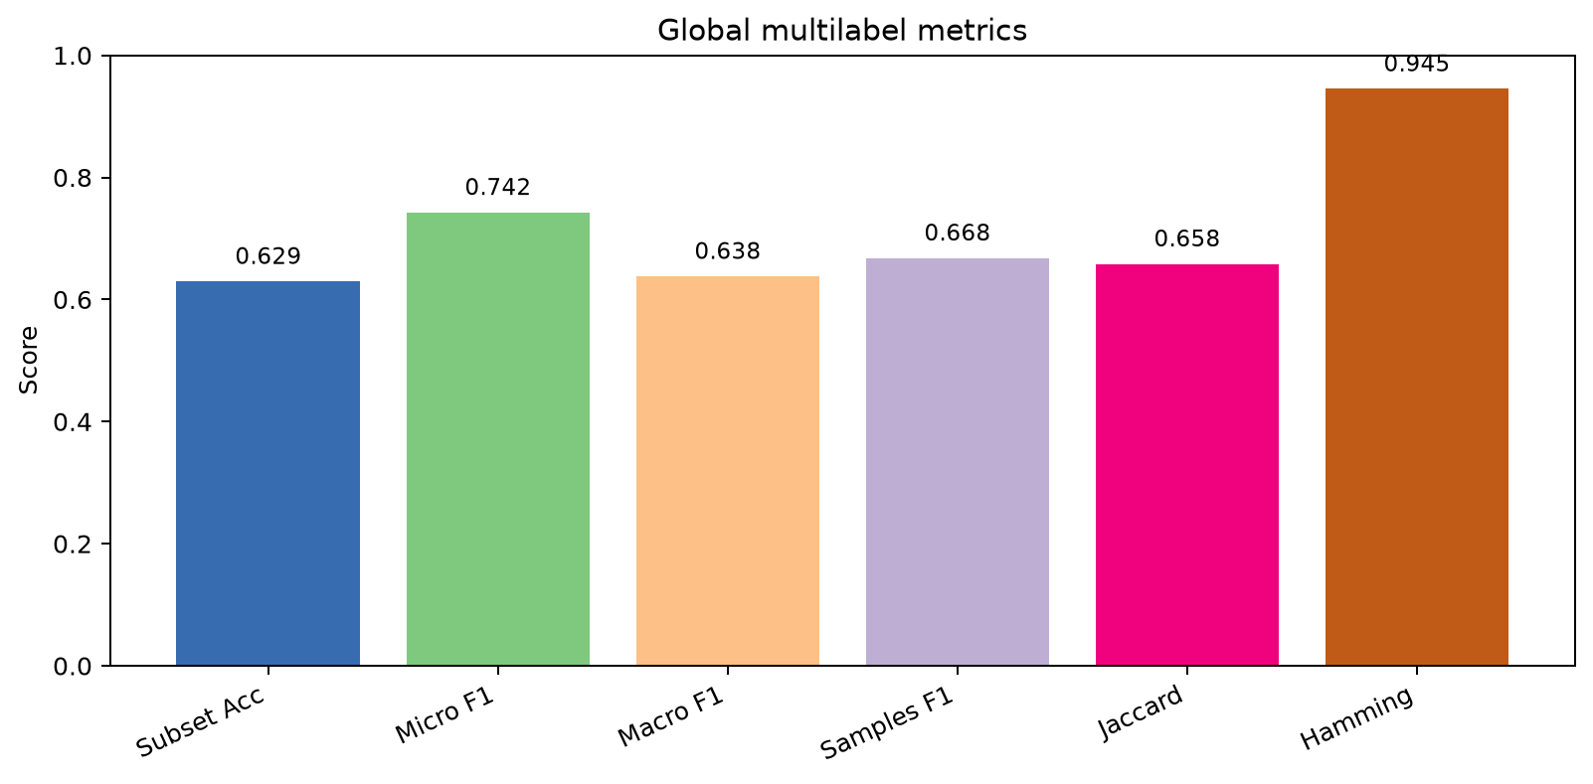
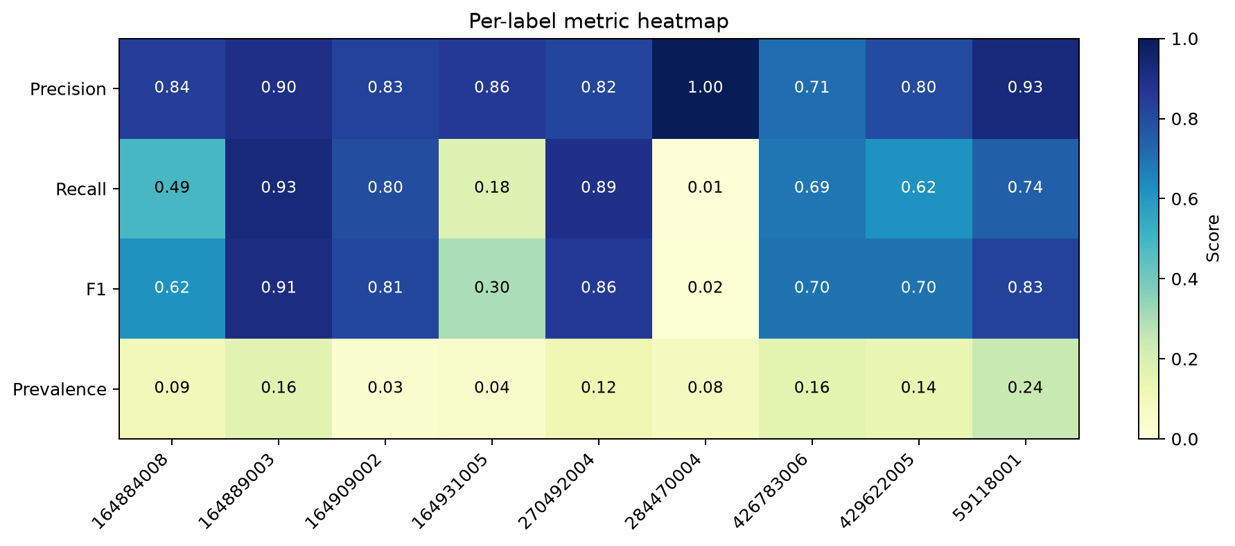
Oversampling - Length 10 - General Results
Experiment Name | cnn-oversample-l10
dataset | precomputedsplit-genlength-10
Model | 2d-CNN
Variant | default
iterations | 20

Slide 31
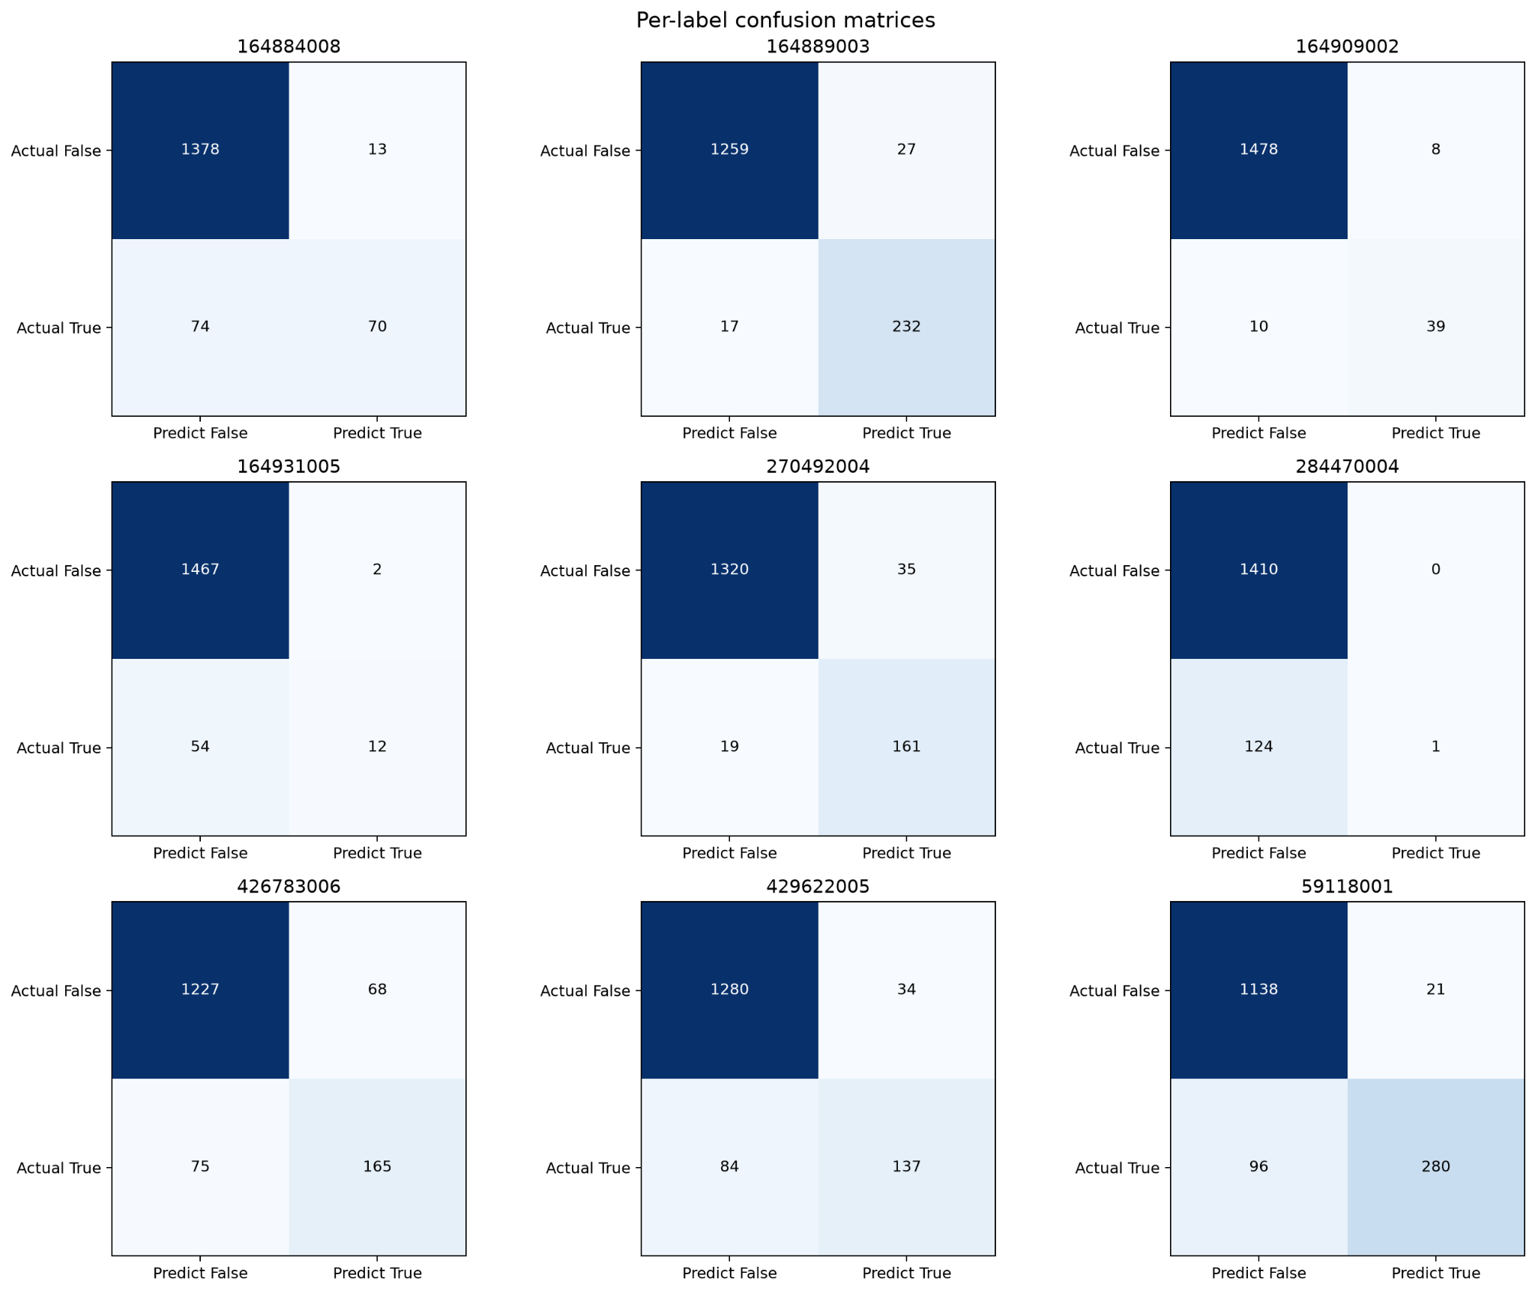
Oversampling - Length 10 - Confusion Matrix

Slide 32
Oversampling - Length 10 - Summary
Performance improvements compound - higher than individual optimizations
Training speed slower
Oversampling improved precision, but recall is still poor for underrepresented classes
Oversampling 284470004 worsens performance for all other classes
Increasing length has negative impact on recall, but positive on precision

Slide 33
LSTM Layers

Slide 34
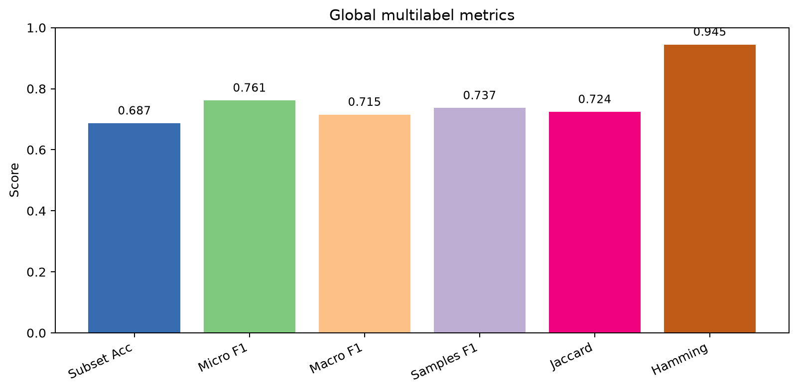
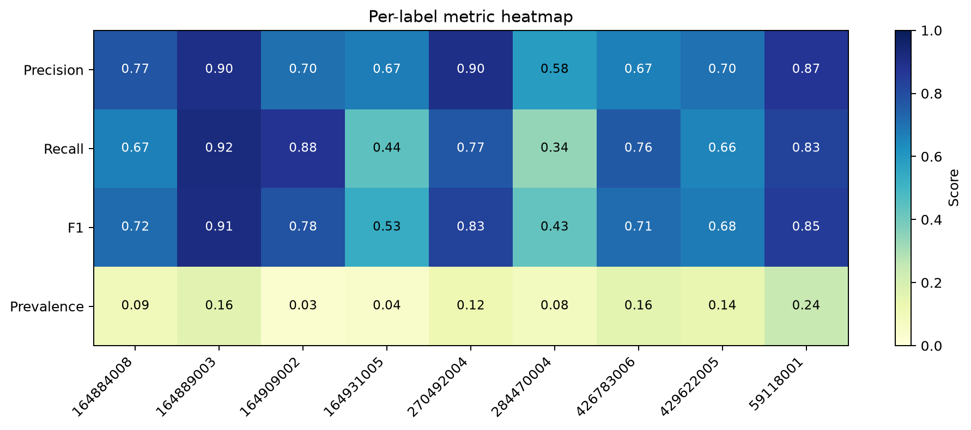
LSTM - Dimensional - General Results
Experiment Name | cnn-ltsm-l10-oversample-it25
dataset | precomputedsplit-genlength-10
Model | 2d-CNN (LTSM)
Variant | ltsm-time
iterations | 25

Slide 35
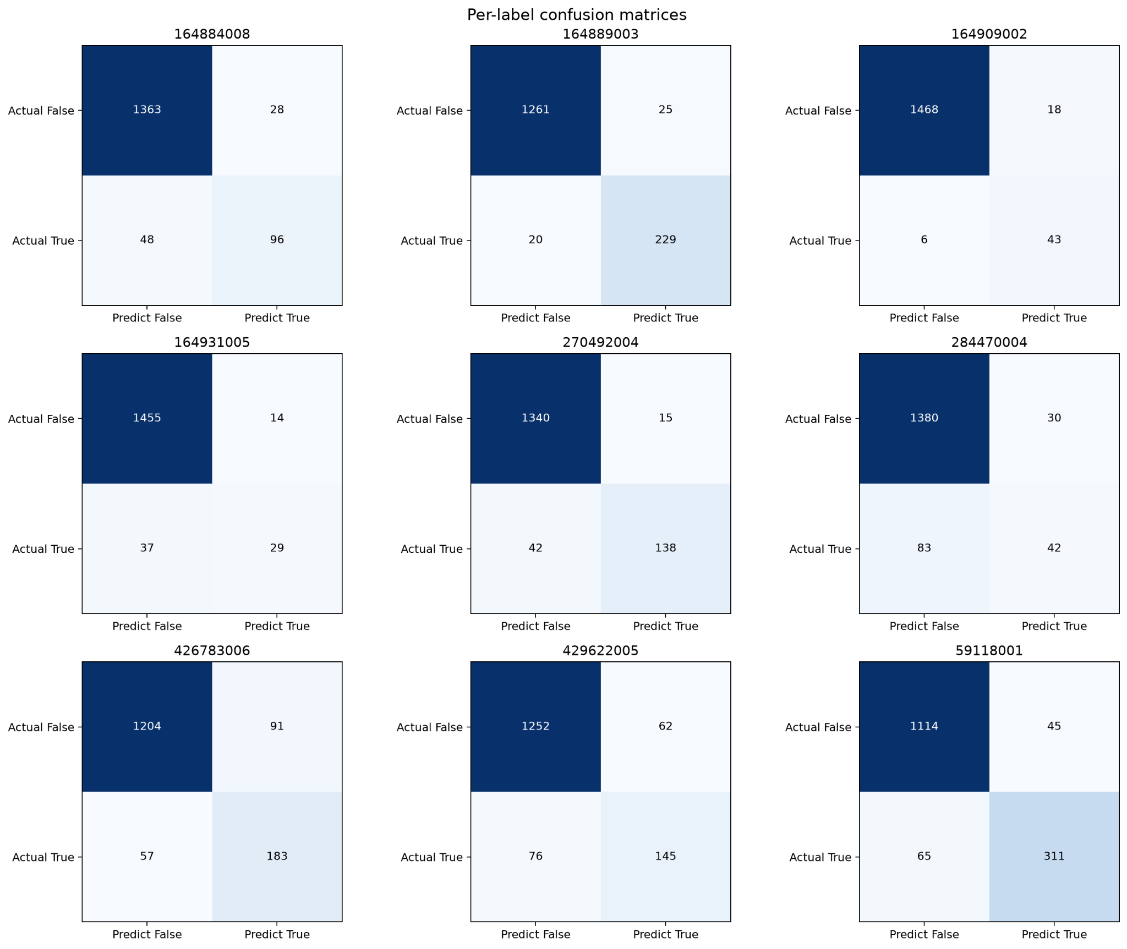
LSTM - Dimensional - Confusion Matrix

Slide 36
LSTM - Dimensional - Summary
Very Slow training - necessitates CUDA Acceleration
Best Overall performance - Accuracy, Precision, Recall
Best performance for problem classes
More resistance to overfitting than standard 2D-CNN architecture
Less resistant to overfitting than temporal
~95% accuracy for individual labels
Quick improvement in training

Slide 37
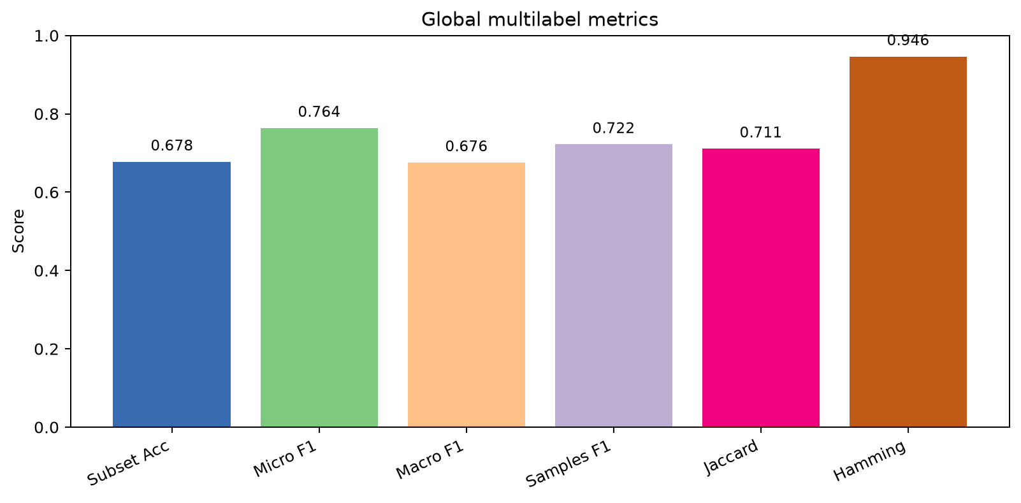
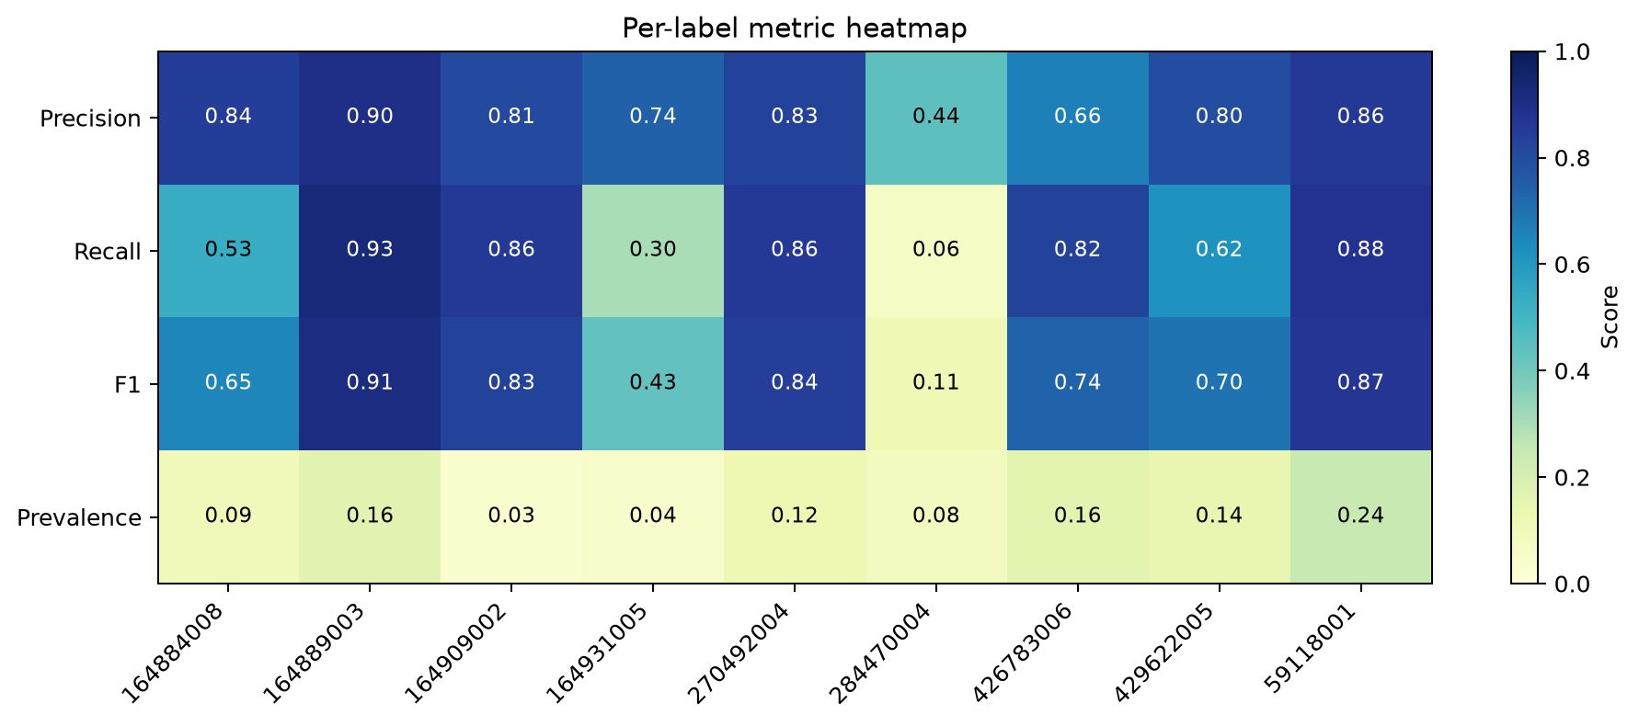
LSTM - Temporal - General Results
Experiment Name | cnn-ltsm-time-l10-oversample-it25
dataset | precomputedsplit-genlength-10
Model | 2d-CNN (LSTM)
Variant | ltsm-time
iterations | 25

Slide 38
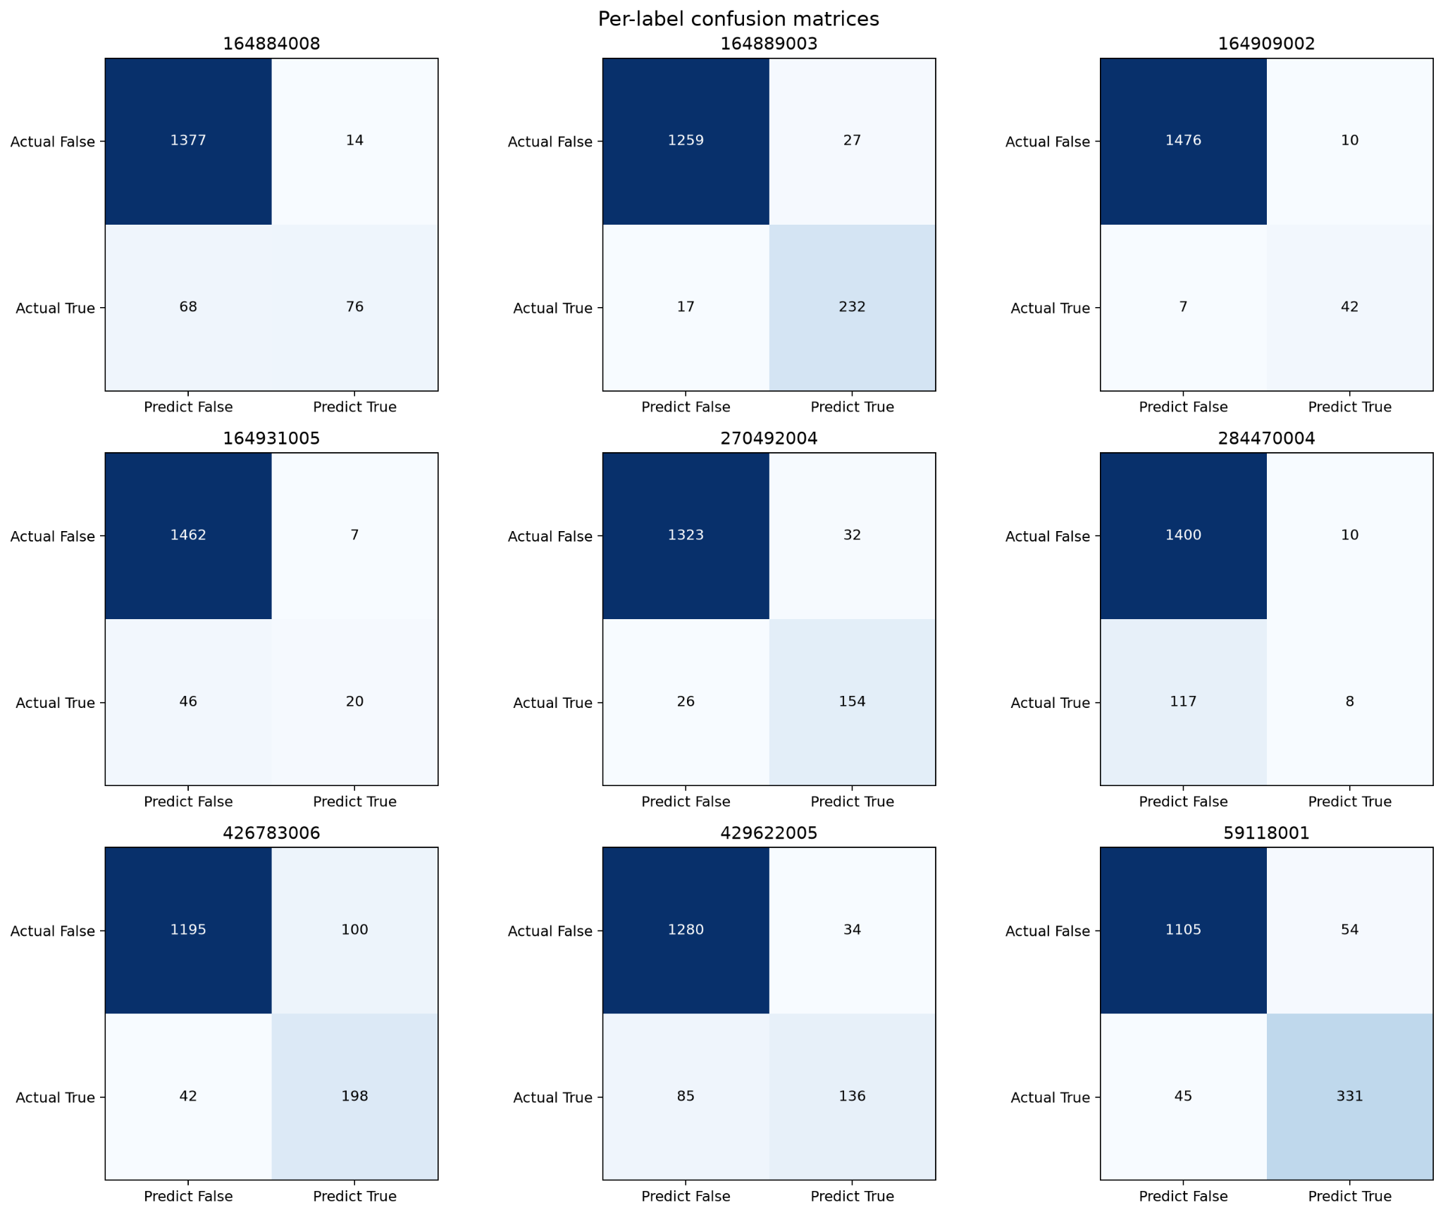
LSTM - Temporal- Confusion Matrix

Slide 39
LSTM - Temporal - Summary
Very Slow training - necessitates CUDA Acceleration
Comparable performance to dimensional LSTM
Worse performance than dimensional LSTM for low class representation
More resistance to overfitting than Temporal LSTM
Higher potential ceiling

Slide 40
Thank you for your attention

